Slide 1
Predicting Heart Disease in Individuals using Biological Data
Divya Singh

Slide 2
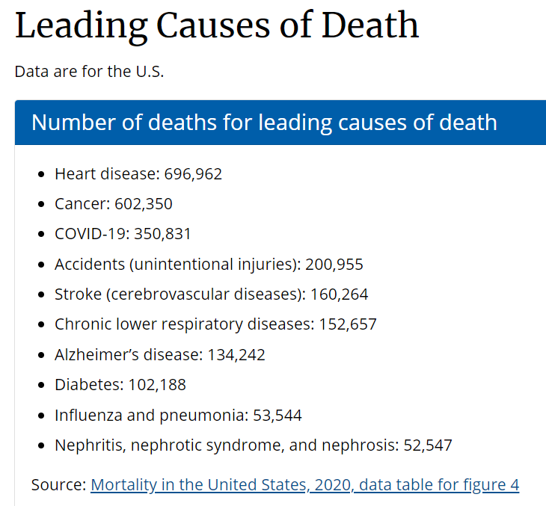
Heart disease: a longstanding pressing health issue
Heart disease was considered the leading cause of death in the U.S. in 2020 (CDC)
In dealing with widespread disease, as evidenced during the COVID-19 pandemic, governments can reduce public health risk to populations and hospitals.
Understanding the risk that heart disease poses can allow groups to spread awareness of healthy behavioral changes to target populations or focus medical resources on mitigation and prevention.
Source: https://www.cdc.gov/nchs/fastats/leading-causes-of-death.htm

Slide 3
Incorporating Machine Learning
Machine learning models employing classification techniques can help analyze whether populations with certain clinical traits may be susceptible to contracting heart disease.
While models cannot, and should not, be used to diagnose individual patients in place of medical professionals, these algorithms can help professionals understand how a disease may affect populations containing many patients with different characteristics.
Using a dataset compiled by the UCI Machine Learning Repository and further refined by Kaggle user fedesoriano, I have created two models that classify subjects as having or not having heart disease.
By using an Extreme Gradient Boosting method, the model achieved a precision metric of 86.5% and a recall metric of 85.0%
A random forest classifier using the same dataset achieved a precision metric of 86.3% and a recall metric of 89.4%

Slide 4
Examining the dataset
Original Dataset
Raw dataset pulled from Kaggle (fedesoriano): 918 observations, 12 features including the target variable.
7 categorical variables, 5 numerical
Each observation represents one subject from one of five medical databases across in the U.S. and Europe
Feature Engineering
Rows with values of 0 for RestingBP, Cholesterol, and MaxHR were removed.
After EDA, rows containing numerical values beyond 3 standard deviations from their column’s mean were removed
Data was scaled using Standard Scaler prior to modeling
Feature names and value definitions (Domínguez):
Age: age of the patient [years]
Sex: sex of the patient [M: Male, F: Female]
ChestPainType: chest pain type [TA: Typical Angina, ATA: Atypical Angina, NAP: Non-Anginal Pain, ASY: Asymptomatic]
RestingBP: resting blood pressure [mm Hg]
Cholesterol: serum cholesterol [mm/dl]
FastingBS: fasting blood sugar [1: if FastingBS > 120 mg/dl, 0: otherwise]
RestingECG: resting electrocardiogram results [Normal: Normal, ST: having ST-T wave abnormality (T wave inversions and/or ST elevation or depression of > 0.05 mV), LVH: showing probable or definite left ventricular hypertrophy by Estes' criteria]
MaxHR: maximum heart rate achieved [Numeric value between 60 and 202]
ExerciseAngina: exercise-induced angina [Y: Yes, N: No]
Oldpeak: oldpeak = ST [Numeric value measured in depression]
ST_Slope: the slope of the peak exercise ST segment [Up: upsloping, Flat: flat, Down: downsloping]
HeartDisease: output class [1: heart disease, 0: Normal]

Slide 5
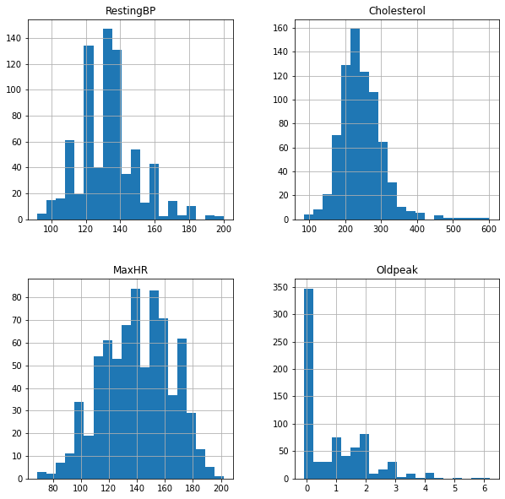
EDA - Numerical Variables
Histograms were generated prior to the removal of outliers
The Oldpeak column has a more prominent tail than the other graphs
13 rows in the original dataset that had negative values in this column. Since these rows also had a 0 cholesterol value, they were removed from the final dataset used for analysis.
The other graphs have unique characteristics but visually appear to more closely resemble a normal distribution than the Oldpeak graph does.

Slide 6
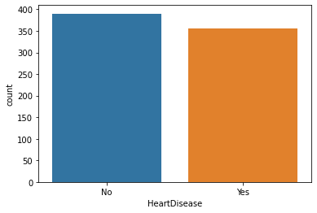
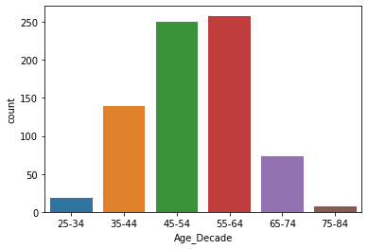
EDA - Categorical Variables
Nearly half of the subjects had heart disease in the final dataset
Age data was consolidated into buckets. Most subjects were between the ages of 44 and 65.

Slide 7
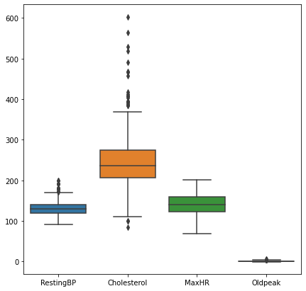
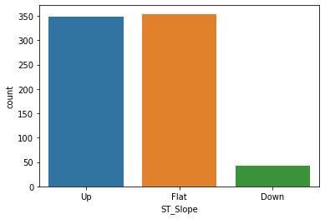
EDA (cont’d)
Most subjects had a ST segment that was sloped either flat or downward.
The cholesterol column had the most notable outliers.

Slide 8
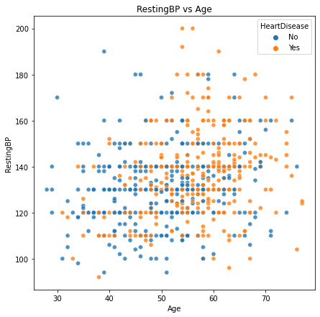
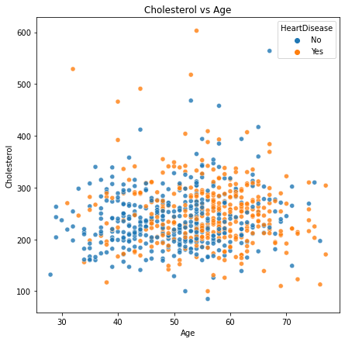
EDA - 2-Variable Relationships
There does not seem to be a distinct correlation between resting blood pressure and heart disease, but, the graph seems to indicate that the presence of heart disease increases in older subjects.
There does not appear to be a distinct correlation between cholesterol and heart disease; however,, this graph also indicates that the presence of heart disease increases in older subjects.

Slide 9
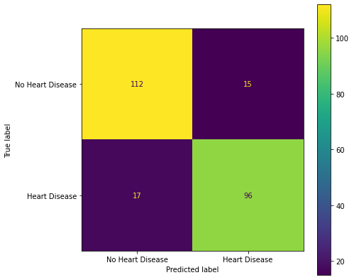
Modeling - Extreme Gradient Boosting
67% of the refined dataset was used to train the model, where 33% was used for testing
Ensemble methods used to create machine learning model. First model used Extreme Gradient Boosting
The confusion matrix was generated to evaluate the model performance
The model achieved a precision metric of 86.5% and a recall metric of 85.0%
Recall was the metric of choice because of focus on false negatives

Slide 10
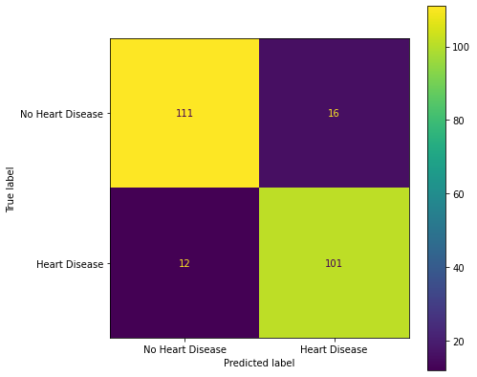
Modeling - Random Forest Classification
Second ensemble method chosen was random forest
67% of the refined dataset was used to train the model, where 33% was used for testing
Hyperparameters chosen include: max_depth = 10, min_samples_leaf = 3, min_samples_split = 4, and n_estimators = 200
A random forest classifier using the same dataset achieved a precision metric of 86.3% and a recall metric of 89.4%

Slide 11
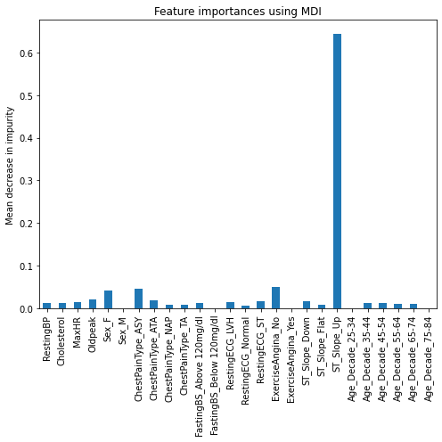
Feature Importances - Mean Decrease in Impurity
Two approaches taken to determine feature importance
Here, the one-hot encoded “ST_Slope_Up” feature is highlighted as having a high score for classification. This feature has a value of 1 for subjects with an ST segment observed with an increasing slope and a value of 0 for flat or decreasing slopes.
May be less relevant for the numerical columns, as the approach may encounter problems with features having high cardinality.

Slide 12
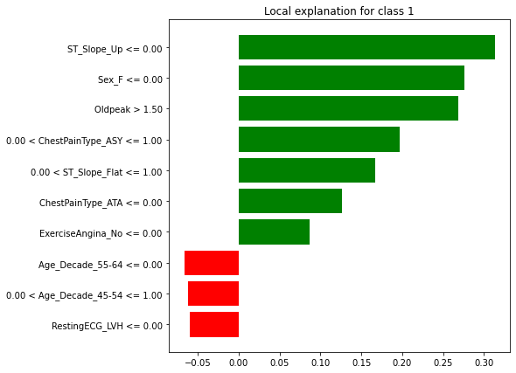
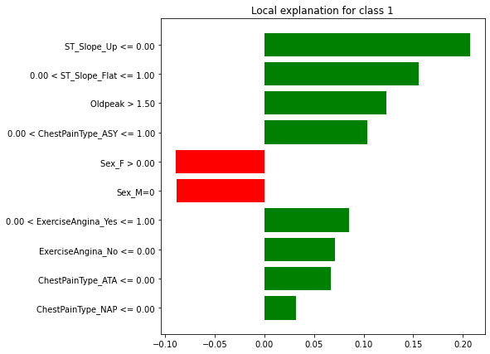
LIME Implementation
Second approach leverages LIME - local interpretable model-agnostic explanations
Both examples above illustrate feature importances for individual classifications (left: XGBoost, right: random forest)

Slide 13
Takeaways and Next Steps
Since we’re optimizing for recall, random forest classification depicted better performance than XGBoost
We could potentially improve random forest performance even more by tuning hyperparameters via GridSearchCV and/or RandomizedSearchCV
Improvement may be modest given current level of performance
Dataset only included 11 independent variables and observations collected only from 5 data sources.
Would be interesting to see how additional demographic data related to subject race and income could impact analysis.

Slide 14
Bibliography
CDC – National Center for Health Statistics – Leading Causes of Death. https://www.cdc.gov/nchs/fastats/leading-causes-of-death.htm. February 3, 2022.
fedesoriano. “Heart Failure Prediction Dataset.” Kaggle, 10 Sept. 2021, https://www.kaggle.com/fedesoriano/heart-failure-prediction.
Domínguez, Carlos. “A Detail Description of the Heart Disease Dataset.” Kaggle, Kaggle, 20 Apr. 2020, https://www.kaggle.com/carlosdg/a-detail-description-of-the-heart-disease-dataset.

